Slide 1

ACTIVE DIRECTORY
MANAGING IDENTITIES AND ACCESS IN WINDOWS ENVIRONMENTS

Slide 2

AGENDA
WHAT IS ACTIVE DIRECTORY
KEY FEATURES OF ACTIVE DIRECTORY
COMPONENTS OF ACTIVE DIRECTORY
ACTIVE DIRECTORY SERVICES
DOMAIN CONTROLLERS
GROUP POLICY
BENEFITS OF ACTIVE DIRECTORY
REAL-WORLD USE CASES
CONCLUSION

Slide 3
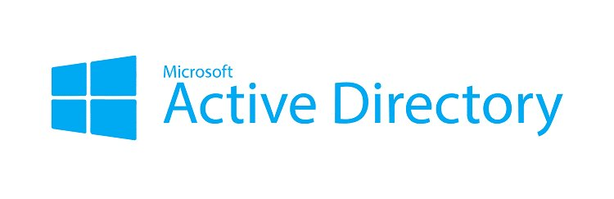
WHAT IS ACTIVE DIRECTORY
Active Directory (AD) is a directory service developed by Microsoft.
It stores information about users, computers, and other resources in a network.
AD helps manage permissions and access to networked resources.

Slide 4
KEY FEATURES OF ACTIVE DIRECTORY
Authentication and authorization
Group Policy management
Scalability and replication
Integration with other Microsoft services
Centralized resource and user management

Slide 5
Domain – Logical group of network objects (users, computers)
Tree – Collection of one or more domains
Forest – Collection of trees sharing a common schema
Organizational Units (OUs) – Containers for organizing objects
Objects – Users, groups, computers, printers, etc.
COMPONENTS OF ACTIVE DIRECTORY

Slide 6
ACTIVE DIRECTORY SERVICES
AD DS (Directory Services) – Core service for storing directory data
AD FS (Federation Services) – Single sign-on (SSO) across organizations
AD CS (Certificate Services) – Manages digital certificates
AD RMS (Rights Management Services) – Protects digital information

Slide 7
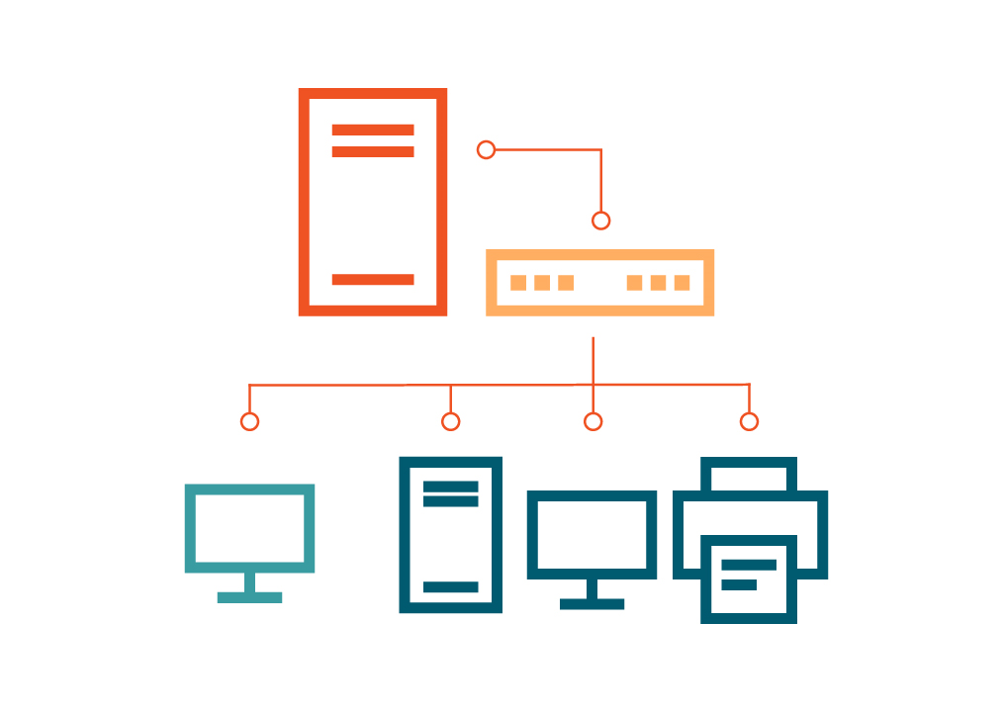
Domain Controllers
Servers that run AD DS and manage security and access
Handle login requests and directory lookups
Replicate data across other domain controllers

Slide 8

Group Policy
Used to manage user and computer settings in a domain
Helps enforce security settings, software installation, and more
Applied through Group Policy Objects (GPOs)

Slide 9
Centralized administration
01
Improved security and access control
02
Scalability for large organizations
03
Simplified user and resource management
04
Benefits of Active Directory

Slide 10
Real-World Use Cases
Managing employee access in corporate networks
Enforcing security policies in schools and universities
Integrating with cloud services like Azure AD

Slide 11
CONCLUSION
Active Directory is essential for managing users and resources in Windows networks.
01
It provides security, scalability, and centralized control.
02
Widely used in enterprise IT environments.
03

